Slide 1
Dynamic Inversion
Suvo Ganguli

Slide 2
Overview
Introduction
Theory
Example
Special Cases

Slide 3
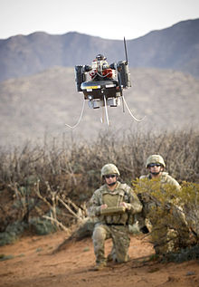
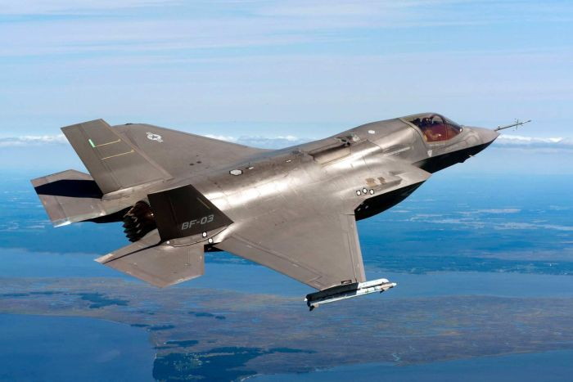
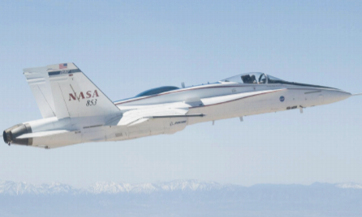
Introduction
Dynamic Inversion control law has been implemented in many real-world applications
Key Idea:
Use inversion to cancel out the undesirable dynamics of a system
Replace dynamics with a desirable one
T-Hawk
Joint Strike Fighter
F/A 18
Notes:
JSF: Lockheed Martin X35 based, F/A 18: Boeing & Northrup Grumman, T-Hawk: ducted fan VTOL micro UAV (The hovering feature of MAV has been critical for U.S. forces in Iraq that search for roadside bombs)

Slide 4

Theory
Plant Dynamics
$\dot{x}=Ax+Bu$
$y=Cx → \dot{\dot{y}=CAx+CBu}$
Control Law
$u={\left(CB\right)}^{−1}(\dot{y}−CAx)$
${\dot{y}= \dot{y}}_{des}=K\left(y_{c}−y\right)$
Closed loop Dynamics
$K\left(y_{c}−y\right)=CA\dot{x}−CB\left[{\left(CB\right)}^{−1}\left(\dot{y}−CAx\right)\right]$
$K\left(y_{c}−y\right)=\dot{y}$
$\frac{y}{y_{c}}=\frac{K}{(s+K)}$

Slide 5

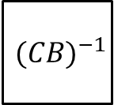
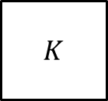
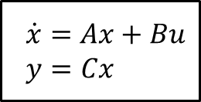


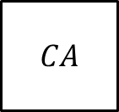
Block Diagram
desired dynamics
inversion
$$y$$
$$y_{command}$$
$$K$$
$${(CB)}^{−1}$$
$\dot{x}=Ax+Bu$
$y=Cx$
$$x$$
$$CA$$

Slide 6
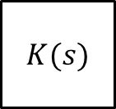

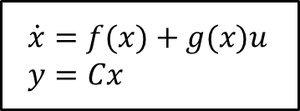

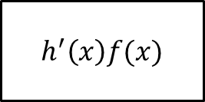
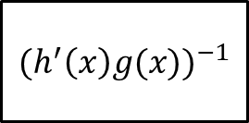

Block Diagram (nonlinear plant)
desired dynamics
inversion
$$y_{command}$$
$$K(s)$$
$${(h^{′}\left(x\right)g(x))}^{−1}$$
$\dot{x}=f(x)+g(x)u$
$y=Cx$
$$y$$
$$x$$
$$h^{′}\left(x\right)f(x)$$

Slide 7

Example 1 (1st order plant)
Plant Dynamics
$\dot{x}=−4x+0.5u$
$y=x$
Control Law
$CB=0.5, CA=−4, K=2$
$u={\left(0.5\right)}^{−1}\left(\dot{y}+4x\right)$
${\dot{y}= \dot{y}}_{des}=2\left(y_{c}−y\right)$
Closed loop Dynamics
$\dot{x}=−4x+$ $0.5{\left(0.5\right)}^{−1}\left(\dot{y}+4x\right)=−4x+2\left(y_{c}−y\right)+4x=2\left(y_{c}−y\right)$, $\dot{x}=\dot{y}$
$\frac{y}{y_{c}}=\frac{2}{(s+2)}$

Slide 8
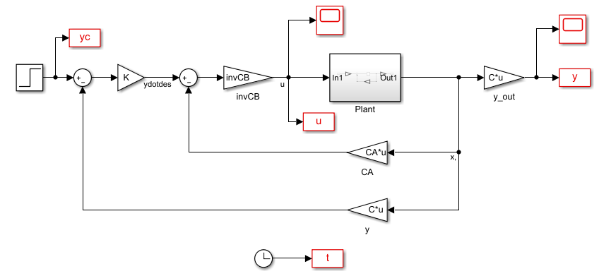
Simulink Block Diagram

Slide 9
Simulation Output
y = closed loop, yo = open loop, yc = command
u = control

Slide 10
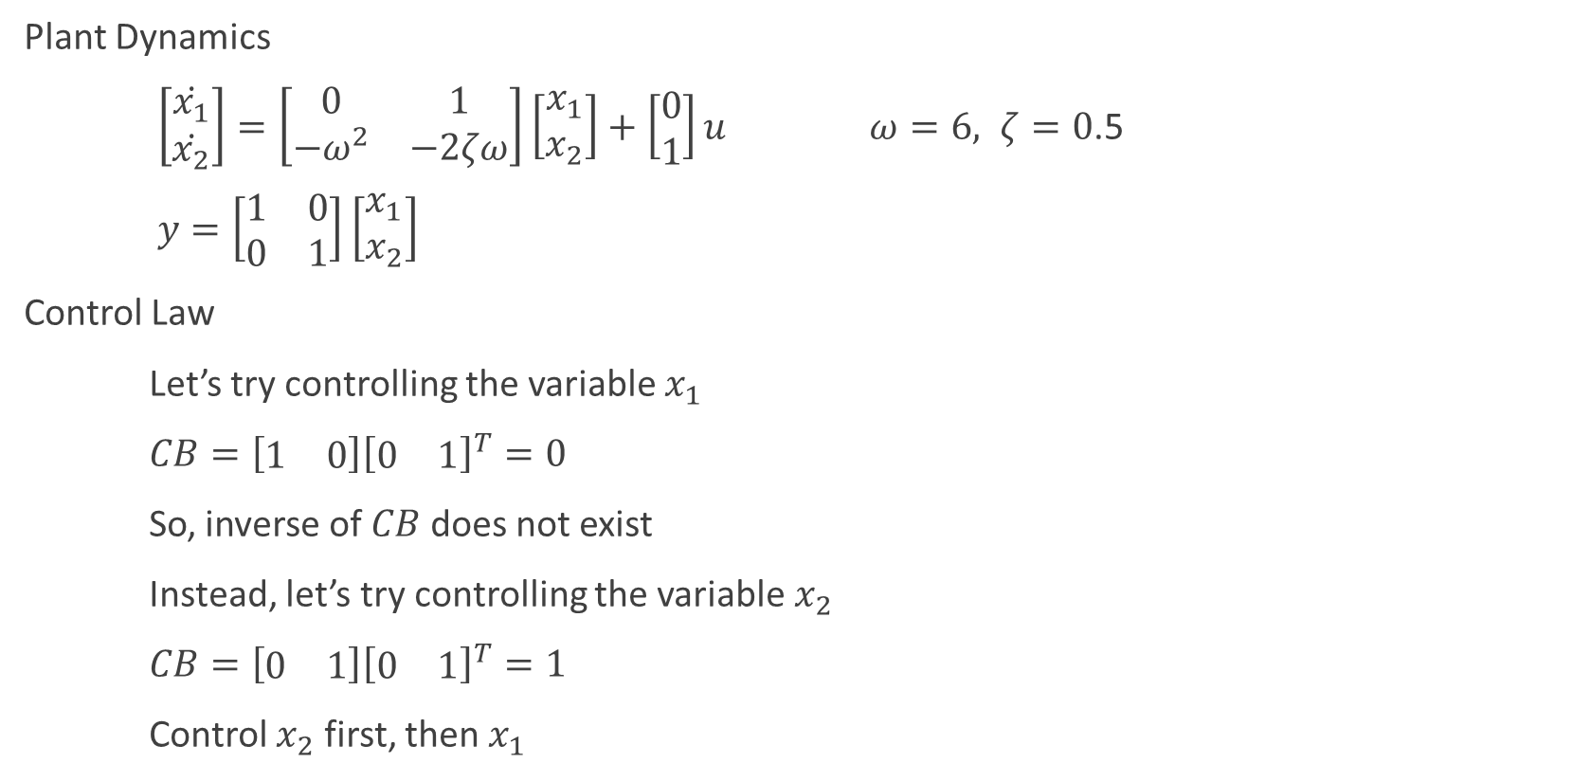
Example 2 (2nd order plant)
Plant Dynamics
$\left[\begin{matrix}\dot{x_{1}} \\ \dot{x_{2}}\end{matrix}\right]=\left[\begin{matrix}0 & 1 \\ −ω^{2} & −2ζω\end{matrix}\right]\left[\begin{matrix}x_{1} \\ x_{2}\end{matrix}\right]+\left[\begin{matrix}0 \\ 1\end{matrix}\right]u$ $ω=6, ζ=0$.5
$y=\left[\begin{matrix}1 & 0 \\ 0 & 1\end{matrix}\right]\left[\begin{matrix}x_{1} \\ x_{2}\end{matrix}\right]$
Control Law
Let’s try controlling the variable $x_{1}$
$CB=\left[\begin{matrix}1 & 0\end{matrix}\right]{\left[\begin{matrix}0 & 1\end{matrix}\right]}^{T}=0$
So, inverse of $CB$ does not exist
Instead, let’s try controlling the variable $x_{2}$
$CB=\left[\begin{matrix}0 & 1\end{matrix}\right]{\left[\begin{matrix}0 & 1\end{matrix}\right]}^{T}=1$
Control $x_{2}$ first, then $x_{1}$

Slide 11

Closed Loop Dynamics
Controlling $x_{2}$
$CB=1$
$CA=\left[\begin{matrix}0 & 1\end{matrix}\right]A=\left[\begin{matrix}{−ω}^{2} & −2ζω\end{matrix}\right]$
$K_{1}=4$
$\frac{x_{2}}{x_{2,c}}=\frac{K_{1}}{(s+K_{1})}$
Controlling $x_{2}$
$\frac{x_{1}}{x_{1,c}}=\frac{K_{2}\frac{K_{1}}{(s+K_{1})}}{s+K_{2}\frac{K_{1}}{(s+K_{1})}}=\frac{K_{2}K_{1}}{s^{2}+sK_{1}+K_{2}K_{1}}$, $K_{2}=1$
$\frac{x_{1}}{x_{1,c}}=\frac{4}{s^{2}+4s+4}$

Slide 12
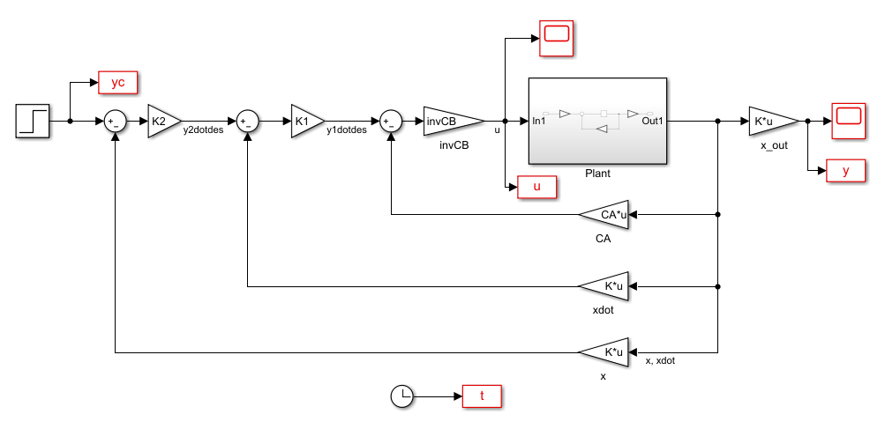
Simulink Block Diagram

Slide 13
Simulation Output
y = closed loop, yo = open loop, yc = command
u = control

Slide 14
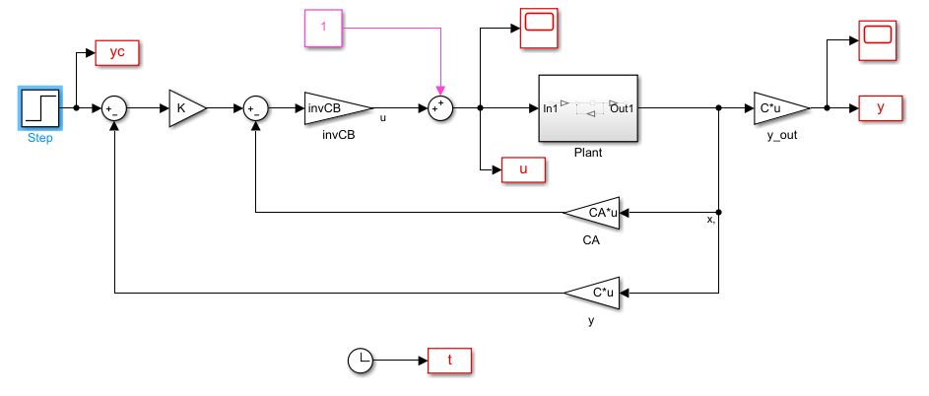
Example 3 (disturbance rejection)
Input Disturbance

Slide 15
Simulation Output
Steady State Error

Slide 16
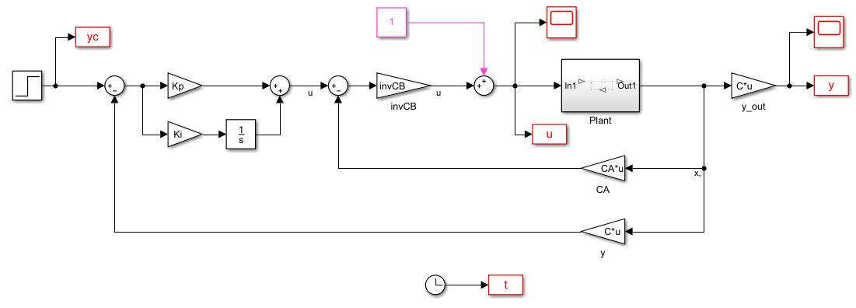
Desired Dynamics with Integrator

Slide 17
Simulation Output
No Steady State Error
Damping Factor = 0.707

Slide 18
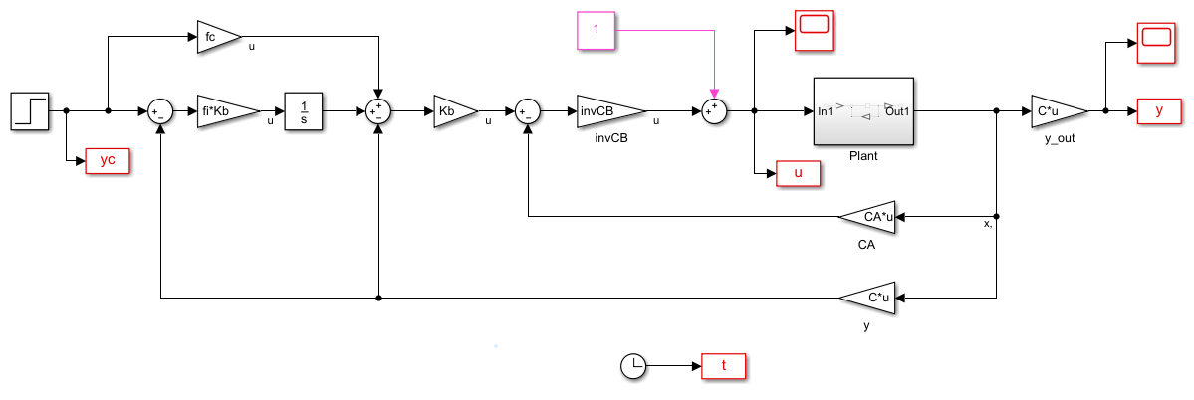
Desired Dynamics with Integrator (version 2)

Slide 19
Simulation Output
No Steady State Error
Damping Factor = 1.0

Slide 20

Example 5 (unstable plant)
Plant Dynamics
$\dot{x}=4x+0.5u$
$y=x$
Control Law
$CB=0.5, CA=2 (=2×4), K=2$
$u={\left(0.5\right)}^{−1}\left(\dot{y}−2x\right)$
${\dot{y}= \dot{y}}_{des}=2\left(y_{c}−y\right)$
Closed Loop Dynamics
$\dot{x}=4x+$ $0.5{\left(0.5\right)}^{−1}\left(\dot{y}−2x\right)=4x+2\left(y_{c}−y\right)−2x=2\left(y_{c}−y\right)+2x$ $\dot{x}=\dot{y}$
$\dot{y}=2y_{c}−4y+2y=2\left(y_{c}−y\right)$
(Don’t cancel unstable pole by inversion)

